Slide 1
The Limits of Risk
Unnatural Disasters
Seminar 14

Slide 2
“not one chance in a million, but one chance in the next decade.”
Charles Perrow, Normal Accidents
What is the problem with risk assessment?

Slide 3
History of risk

Slide 4
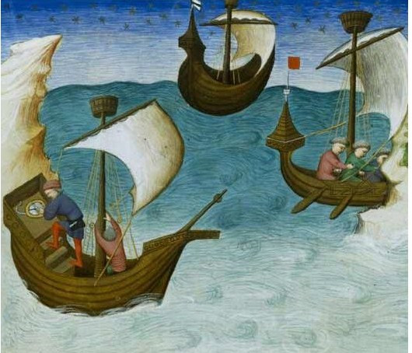
From fate to risk

Slide 5
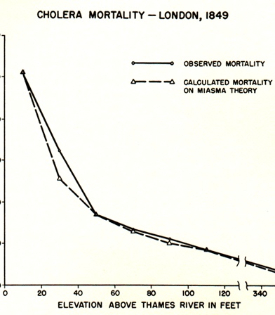
The taming of chance
The future is not deterministic but governed by probabilities
Chance is not random but amenable to accounting and forecasting
Statistics and risk

Slide 6
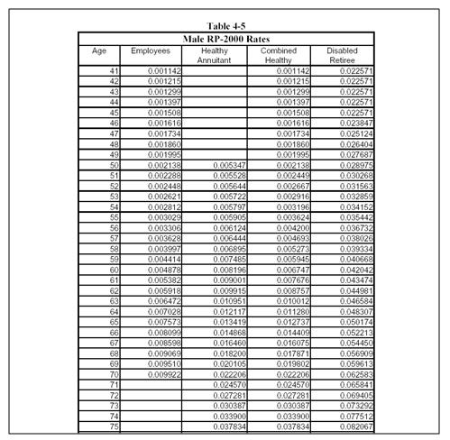
Insurance: modernity’s signature social achievement

Slide 7
Risk
HISTORICAL or ARCHIVAL
Relies on historical patterns of incidence to calculate probability of future events
“the past contains the elements of what is to come” (Lakoff, 402)

Slide 8
Risk
2. POPULATION, NOT INDIVIDUAL
Insurance spreads risk
Cannot prevent harm, but “promises that no one will have to face them alone and destitute, without any resources to compensate for injury and loss” (Jasanoff, 16)

Slide 9
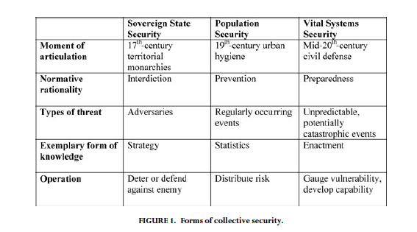

Slide 10
Questions
How is risk different from danger?
How is risk different from harm?

Slide 11
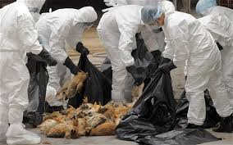
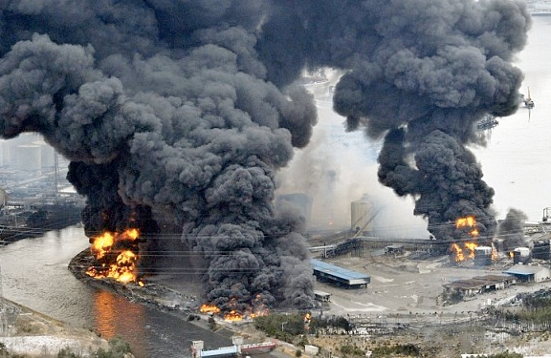
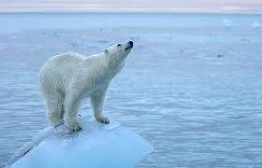
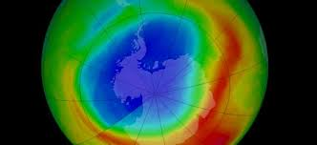
Uninsurable risks

Slide 12
Limits of risk assessment

Slide 13
What can we do about uninsurable risks?

Slide 14
1. Preparedness

Slide 15
Table-top exercise

Slide 16
Reflection: how does scenario exercise differ from risk assessment or risk calculation?

Slide 17
Reflection: what are the limitations of preparedness?

